Slide 1
Digital Image Processing
Image Enhancement
(Point Processing)

Slide 2
Contents
In this lecture we will look at image enhancement point processing techniques:
  What is point processing?
  Negative images
  Thresholding
  Logarithmic transformation
  Power law transforms
  Grey level slicing
  Bit plane slicing

Slide 3
Basic Spatial Domain Image Enhancement
Most spatial domain enhancement operations can be reduced to the form
g (x, y) = T[ f (x, y)]
where f (x, y) is the
input image, g (x, y) is
the processed image
and T is some
operator defined over
some neighbourhood
of (x, y)
Origin
x
(x, y)
y
Image f (x, y)

Slide 4
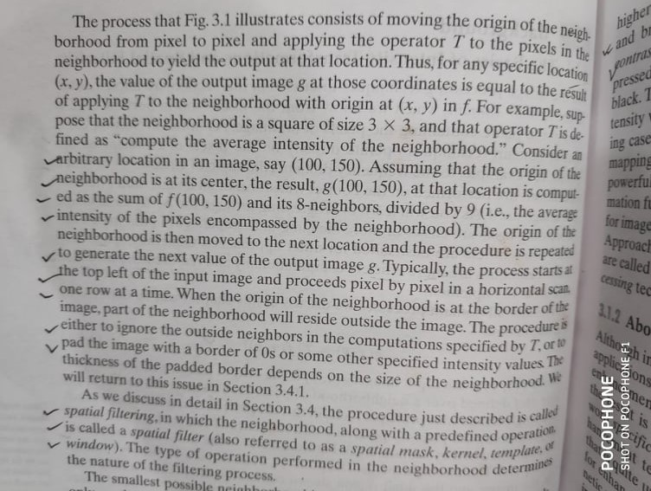

Slide 5
Point Processing
The simplest spatial domain operations occur when the neighbourhood is simply the pixel itself
In this case T is referred to as a grey level transformation function or a point processing operation
Point processing operations take the form
s = T ( r )
where s refers to the processed image pixel value and r refers to the original image pixel value

Slide 6
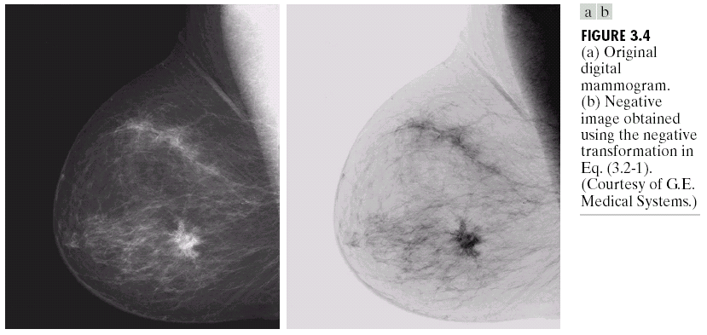

Point Processing Example:
Negative Images
Negative images are useful for enhancing white or grey detail embedded in dark regions of an image
  Note how much clearer the tissue is in the negative image of the mammogram below
Images taken from Gonzalez & Woods, Digital Image Processing (2002)
Original Image
s = 1.0 - r
Negative Image

Slide 7
Point Processing Example:
Negative Images (cont…)
Original Image
x
Enhanced Image
x
y
Image f (x, y)
y
Image f (x, y)
s = intensity_{max} - r

Slide 8
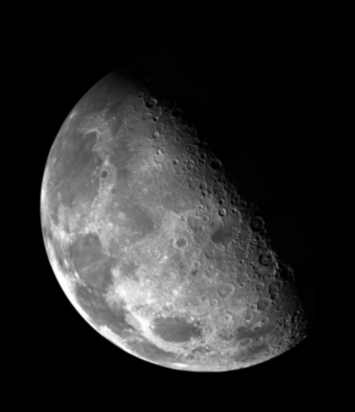

Point Processing Example:
Thresholding
Thresholding transformations are particularly useful for segmentation in which we want to isolate an object of interest from a background
Images taken from Gonzalez & Woods, Digital Image Processing (2002)
1.0
r > threshold
s =
0.0
r <= threshold

Slide 9
Point Processing Example:
Thresholding (cont…)
Original Image
x
Enhanced Image
x
y
Image f (x, y)
y
Image f (x, y)
1.0 r > threshold
s =
0.0 r <= threshold

Slide 10
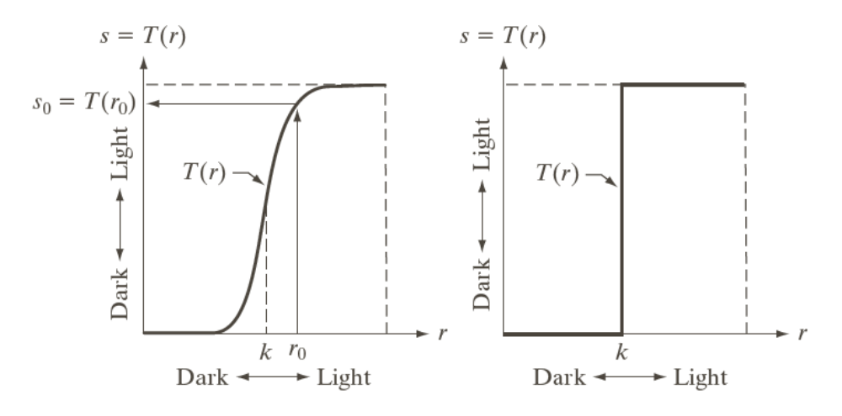
Intensity Transformations
Images taken from Gonzalez & Woods, Digital Image Processing (2002)
Intensity transformation (a) Contrast stretching (b) Thresholding function

Slide 11
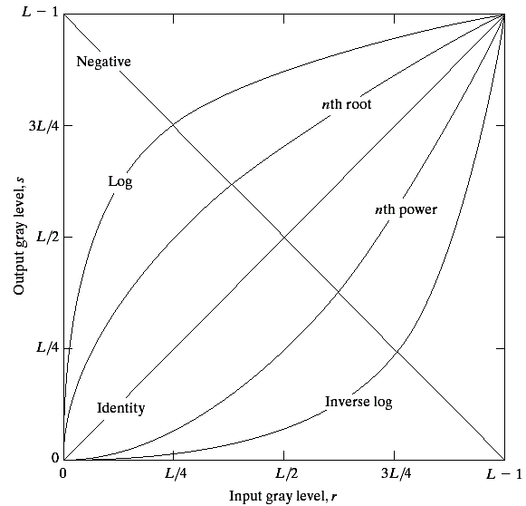
Basic Grey Level Transformations
There are many different kinds of grey level transformations
Three of the most
common are shown
here
  Linear
    Negative/Identity
  Logarithmic
    Log/Inverse log
  Power law
    n^{th} power/n^{th} root
Images taken from Gonzalez & Woods, Digital Image Processing (2002)

Slide 12
Logarithmic Transformations
The general form of the log transformation is
s = c * log(1 + r)
The log transformation maps a narrow range of low input grey level values into a wider range of output values
The inverse log transformation performs the opposite transformation

Slide 13
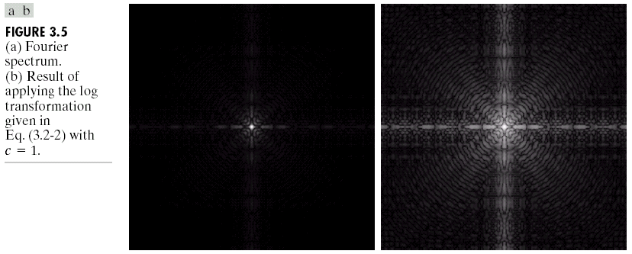
Logarithmic Transformations (cont…)
Log functions are particularly useful when the input grey level values may have an extremely large range of values..
In the following example the Fourier transform of an image is put through a log transform to reveal more detail.
The range is from 0 to 10^6. C=1.
The range of values becomes 0 to 6.2, which is more manageable
Images taken from Gonzalez & Woods, Digital Image Processing (2002)
s = log(1 + r)
C=1

Slide 14
Logarithmic Transformations (cont…)
Original Image
x
Enhanced Image
x
y
Image f (x, y)
y
Image f (x, y)
s = log(1 + r)
We usually set c to 1
Grey levels must be in the range [0.0, 1.0]

Slide 15
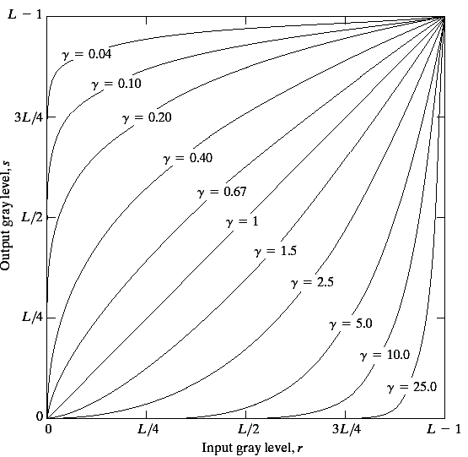
Power Law Transformations
Power law transformations have the following form
s = c * r ^{γ}
Fractional value of γ map
a narrow range
of dark input values
into a wider range of
output values or vice
versa
Varying γ gives a whole
family of curves
Images taken from Gonzalez & Woods, Digital Image Processing (2002)

Slide 16
Power Law Transformations
The exponent in the power law equation is referred to as gamma
The process used to correct these power law response phenomena is called gamma correction
CRT devices have intensity to voltage response.. γ varies from 1.8 to 2.5.
Same procedure applied in scanner and printers…the value of γ is device dependent.

Slide 17
Power Law Transformations (cont…)
Original Image
x
Enhanced Image
x
y
Image f (x, y)
y
Image f (x, y)
s = r ^{γ}
We usually set c to 1
Grey levels must be in the range [0.0, 1.0]

Slide 18
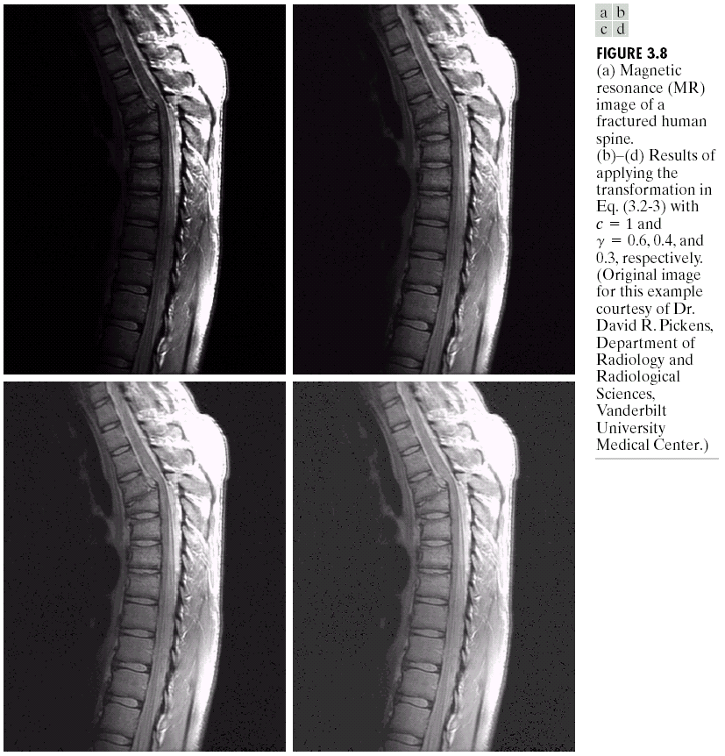
Power Law Example

Slide 19
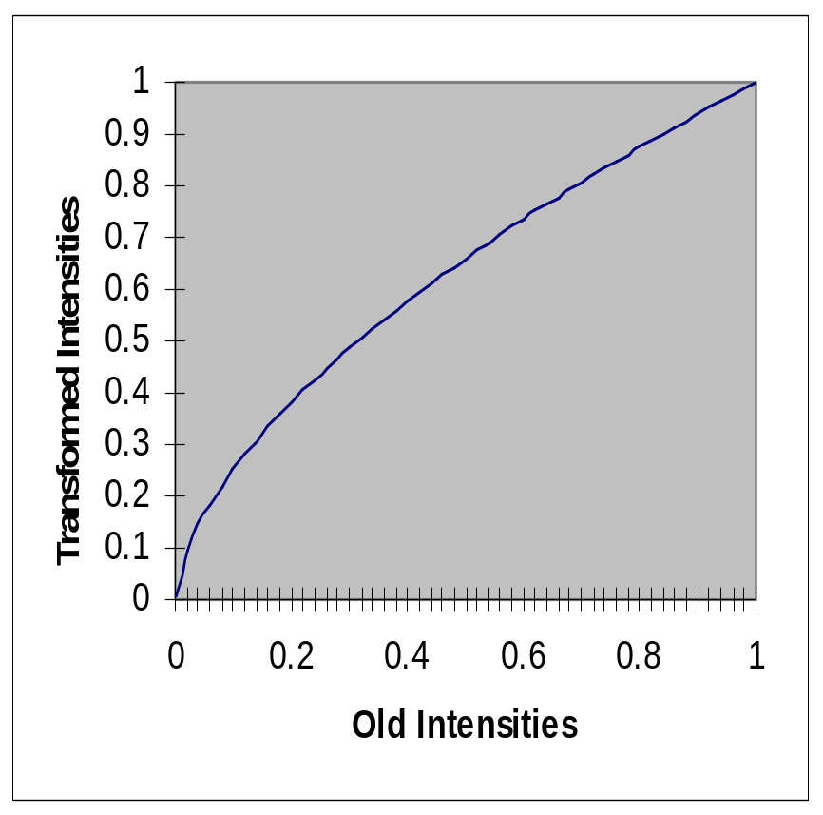
Power Law Example (cont…)
γ = 0.6

Slide 20
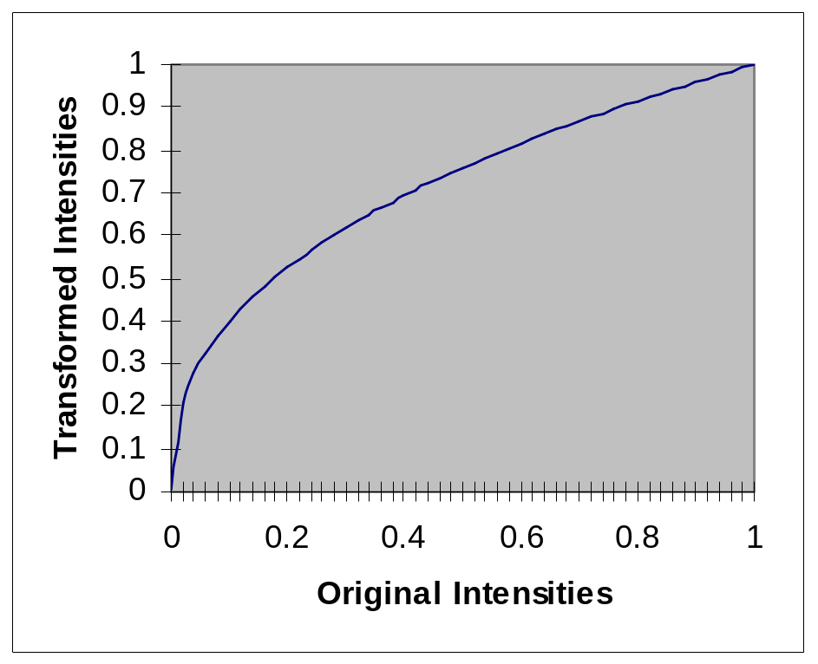
Power Law Example (cont…)
γ = 0.4

Slide 21
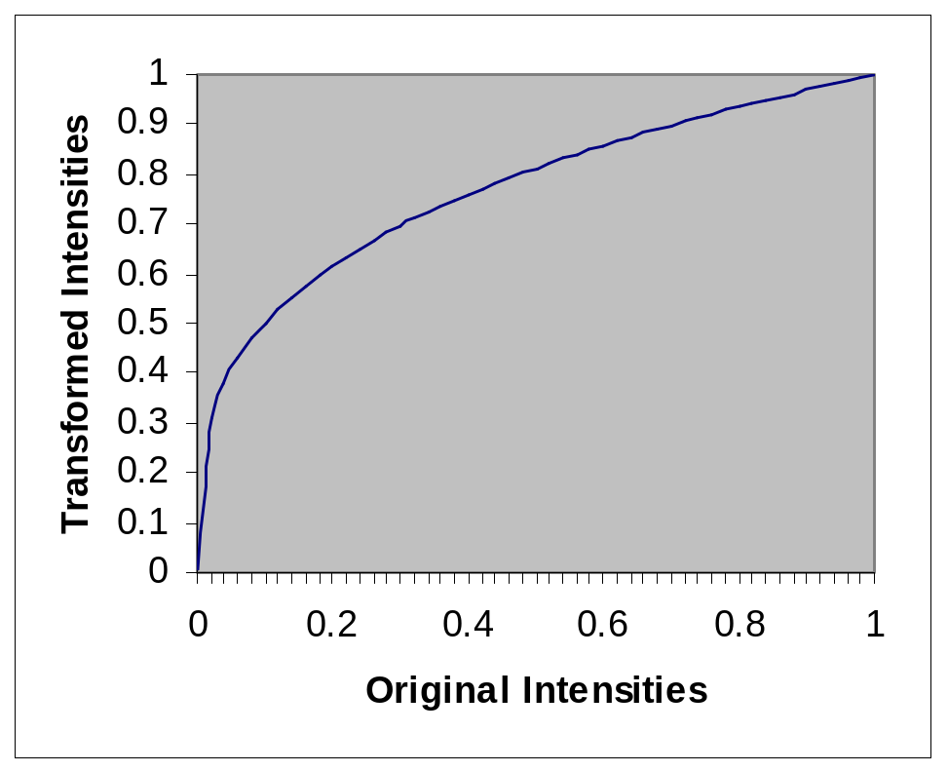
Power Law Example (cont…)
γ = 0.3

Slide 22
Power Law Example (cont…)
The images to the
right show a
magnetic resonance
(MR) image of a
fractured human
spine
Different curves
highlight different
detail
s = r ^{0.6}
s = r ^{0.3}
s = r ^{0.4}
Images taken from Gonzalez & Woods, Digital Image Processing (2002)
Notes:
The third transform is a step too far

Slide 23
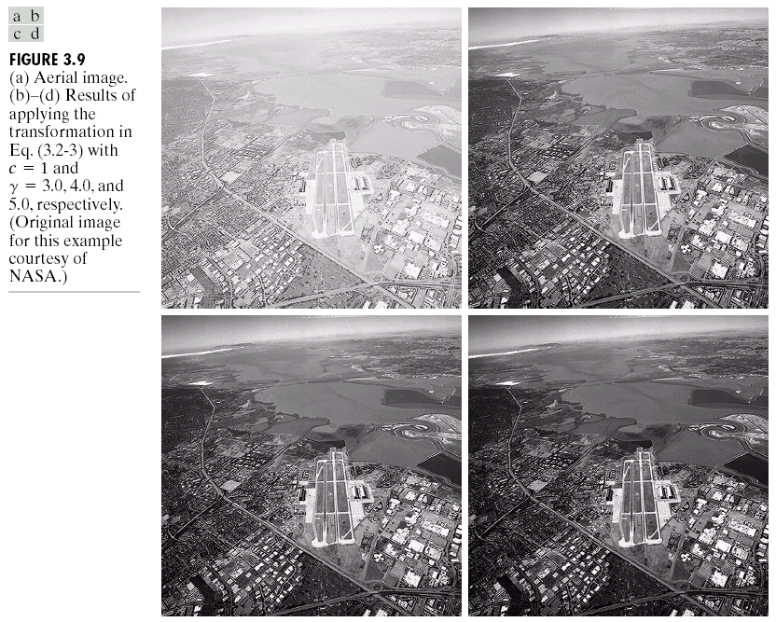
Power Law Example

Slide 24
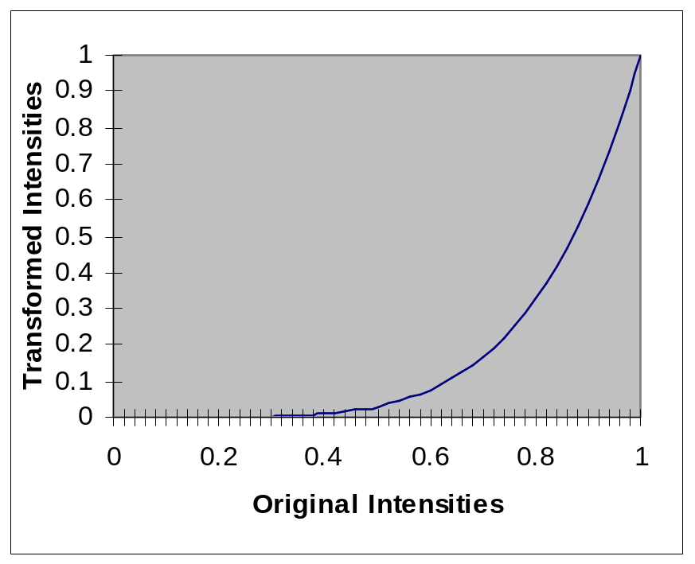
Power Law Example (cont…)
γ = 5.0

Slide 25
Power Law Transformations (cont…)
An aerial photo
of a runway is
shown
This time
power law
transforms are
used to darken
the image
Different curves
highlight
different detail
Suitable results
Were obtained with
Gamma 3.0 and 4.0,
For gamma 5.0 some
details were lost.
s = r ^{3.0}
s = r ^{4.0}
s = r ^{5.0}
Images taken from Gonzalez & Woods, Digital Image Processing (2002)

Slide 26
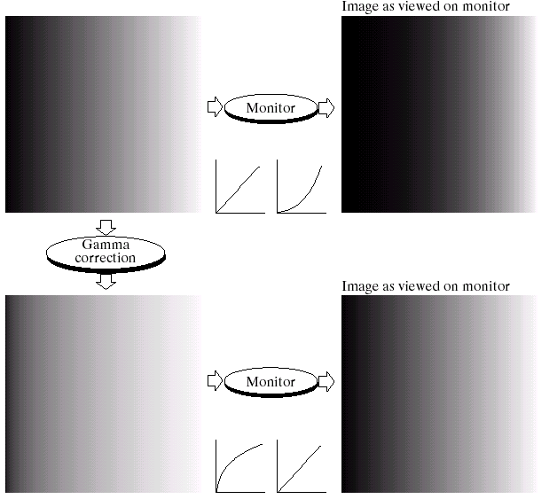
Gamma Correction
Many of you might be familiar with gamma correction of computer monitors
Problem is that
display devices do
not respond linearly
to different
intensities
Can be corrected
using a log
transform
Images taken from Gonzalez & Woods, Digital Image Processing (2002)

Slide 27

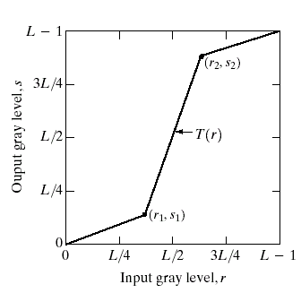
Piecewise Linear Transformation Functions
Rather than using a well defined mathematical function we can use arbitrary user-defined transforms
The images below show a contrast stretching linear transform to add contrast to a poor quality image
Images taken from Gonzalez & Woods, Digital Image Processing (2002)

Slide 28
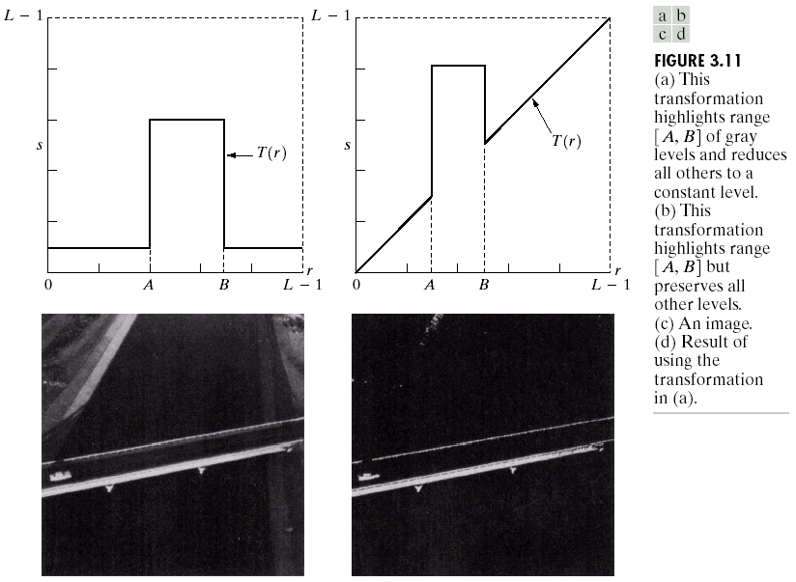
Gray Level Slicing
Highlights a specific range of grey levels
  Similar to thresholding
  Other levels can be
  suppressed or maintained
  Useful for highlighting features
  in an image
Images taken from Gonzalez & Woods, Digital Image Processing (2002)

Slide 29
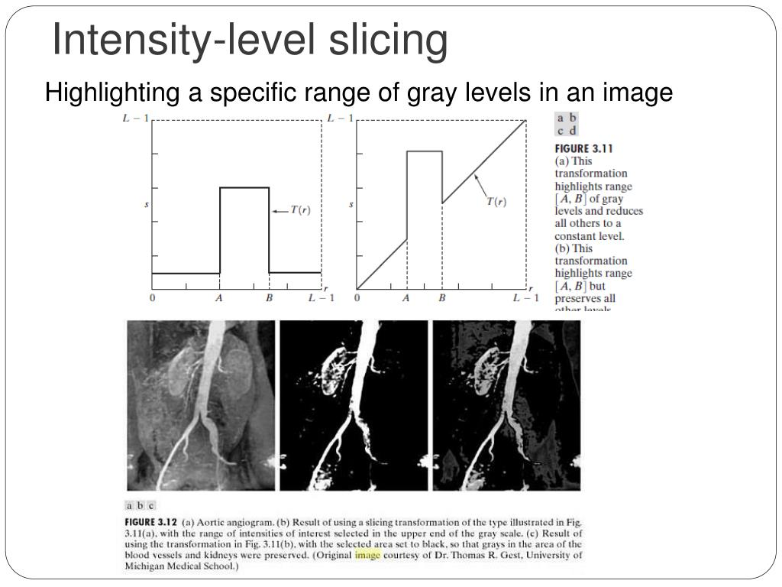

Slide 30
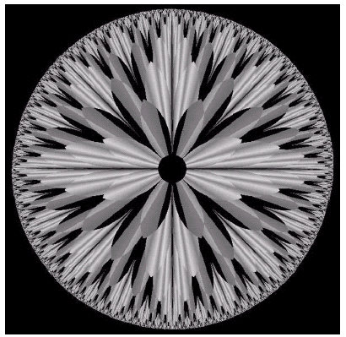
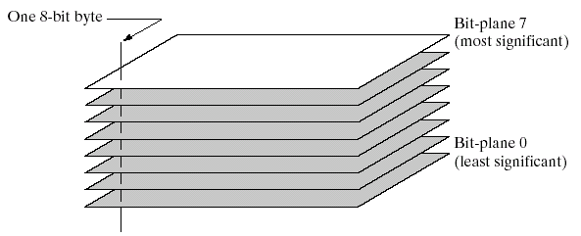
Bit Plane Slicing
Often by isolating particular bits of the pixel values in an image we can highlight interesting aspects of that image
  Higher-order bits usually contain most of the significant visual information
  Lower-order bits contain
  subtle details
Images taken from Gonzalez & Woods, Digital Image Processing (2002)

Slide 31
Summary
We have looked at different kinds of point processing image enhancement
Next time we will start to look at neighbourhood operations – in particular filtering and convolution

